Slide 1
Visual Analysis

Slide 2
Agenda
Introducing Visual Analysis.
Image Recognition
Advanced Visual Functions
Scrolling
Visual Relations

Slide 3
Introducing Visual Analysis

Slide 4
Visual Analysis
Visual Analysis takes a screenshot image from a device and analyzes it for text (Optical Character Recognition) and images (Image Recognition).
When should I use it?
When object analysis is not available for the required element or is becoming difficult to maintain for a specific element
When you want to validate what the user actually sees
Verify layout of the application, landscape vs portrait for instance
When you need to gather timer results for actions
Notes:
Visual analysis should never be used as a replacement for object recognition. Visual analysis should only be used to assist object recognition in the event you are struggling to identify objects or maintain objects in your automation.
Visual Analysis will be working 100% exclusively on “what you see” on the screen (Text or Images), compared to objects which you can not directly see.

Slide 5
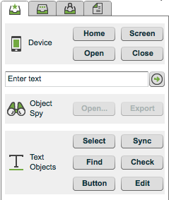
Available Visual Commands
Check/Sync – Validates that the needle appears on the screen
Select/Button – Clicks on the needle
Find – Finds a needle for visual relations
Edit – Get or set text in your application
Notes:
Let’s start with common visual analysis commands in the automation tab.
The same commands are available for both image and text. Text is more stable than images because you can use it across platforms more easily and requires much less maintenance.
Lets review the available commands
Checkpoint – to validate what you’re looking for (needle) appears on the screen.
Sync – same as Checkpoint except that sync by default has a timeout of 60s.
Select – Clicks on needle. Select tries only once to click on an element.
Button - Clicks on needle. Unlike Select, button tries multiple times to click on an element. Button takes longer but is more reliable.
Find – Find’s a particular needle and stores the needle temporarily in memory for visual relations (talk about later).
Edit – Utilize this to set or get text from your application

Slide 6
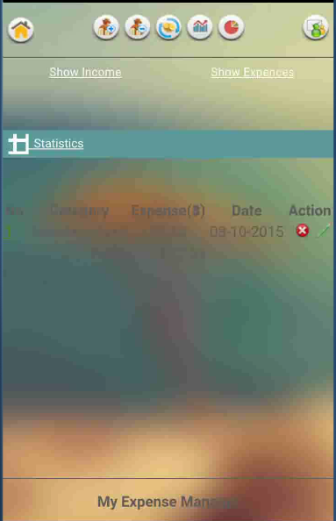
Needle in the Haystack
Basic concepts of visual analysis
Haystack – screenshot of the current page displayed on the device.
Needle – the image or text that we need to find.
Perfecto provides the tools to analyze the screen (haystack) and identify the element (needle).

Slide 7
Advanced Text Analysis
OCR is not a 100% reliable option and in some rare cases you may want to tweak the query with advanced parameters.
Threshold – the “pass grade” is calculated automatically according to string length. The mechanism can be bypassed to force a pass mark above a set threshold.
White space, punctuation & capitalization – ignored by default.

Slide 8
Visual Analysis In Code
Visual Analysis is an extension applied to Appium by Perfecto.
We execute it with the executeScript method supplied by Selenium.
The format of the commands is:
The Developers site & plugin contain the syntax for all the commands & parameters.
Map<String, Object> params1 = new HashMap<>();
params1.put("content", "Netflix");
params1.put("timeout", "30");
params1.put("threshold", "100");
Object result1 = driver.executeScript("mobile:text:find", params1);
Notes:
Do not focus a lot on the explicit parameters or command shown in the code. Focus mainly on the process of the code
Creating a hashmap
Populating the hashmap with parameters (those same parameters are found in OCR and Image Analysis window)
Populating the executeScript command with the command value and hashmap object

Slide 9
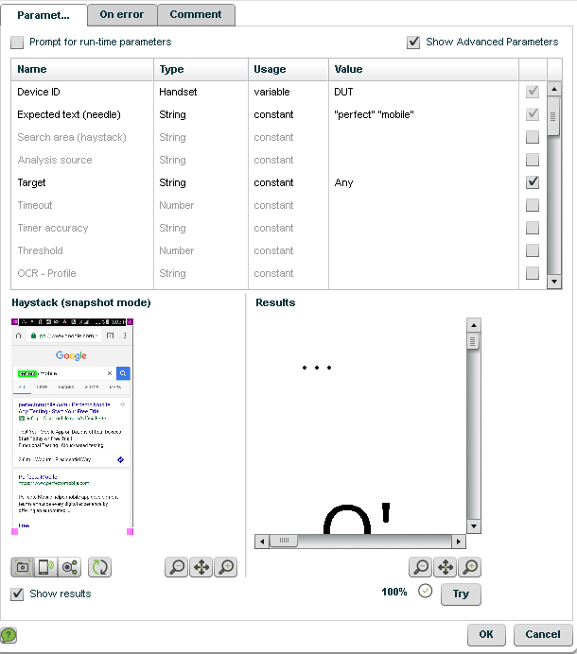
Target Multiple Text Find
When you need to verify multiple text values at once you can encapsulate the text of the Expected text (needle) in quotes and separate them with a space: “perfecto” “mobile”
For all commands you can use the parameter value “Any” for the Target parameter. For example, by setting the parameter to “Any” if any of the words are matched a success will be returned.
Checkpoints have an additional Target parameter which allows you to verify ALL text values are present to be considered a success. To use this, set the parameter value of Target to “All”.

Slide 10
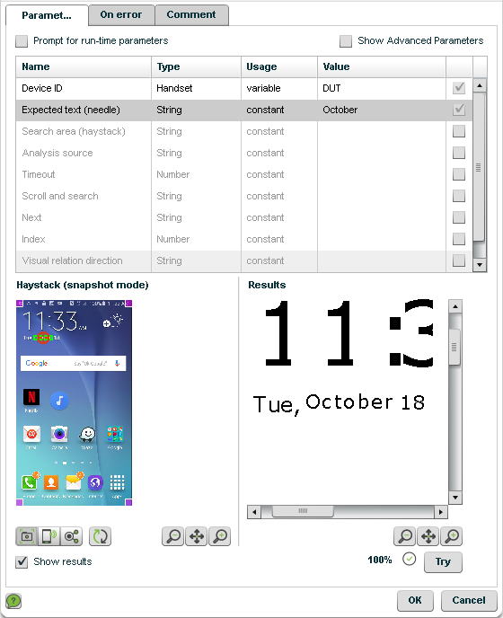
Working with the OCR tool.
The Perfecto Lab provides a tool for analyzing text
Allows trying out all the parameters and viewing results.
Commands can be recorded with the plugin
Notes:
Open the OCR tool from the plugin and walk through the entire flow.
Look for a text, use the try button, work on image & the device.

Slide 11
Image Recognition
Image Recognition

Slide 12
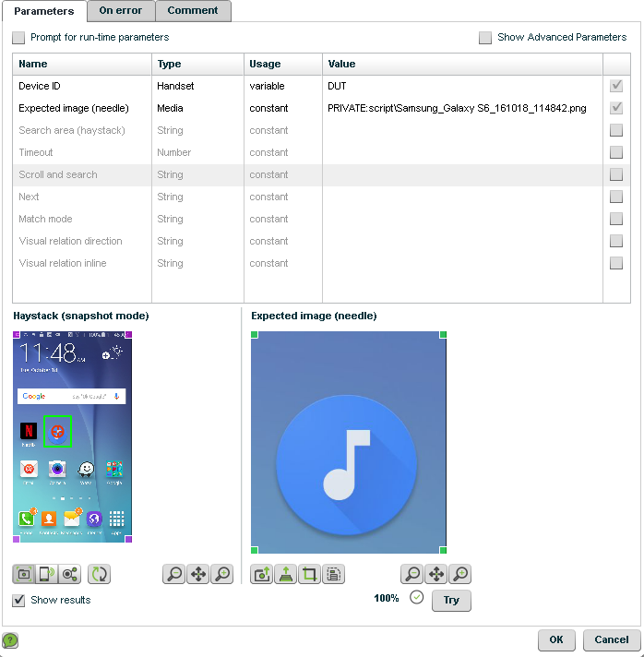
Image Analysis - Parameters
Expected image (needle)
The path to the file repository where your image is hosted
Match mode
Same Size
Needle and haystack must have the same resolution. Use this only when the needle is taken from the same device type you are analyzing.
Any Size:
Haystack may be of any resolution. This increases analysis time.
Bounded Size (Best Practice)
Supports different resolutions which means this will work across different device types.
Reduced analysis time compared to Any Size
To use the same needle image on multiple devices use the below Needle Bound parameter values
70 when searching on a tablet
30 when searching on a phone
Notes:
Demonstrate: Please review each of the parameters in the plugin and demonstrate their functionality. Then record the functionality into code and show how to refactor into a reusable method.

Slide 13
Image Analysis - Haystack
The Haystack window gives you a view of the screenshot taken of the device screen when you opened the Image Analysis window.
You also have commands available to assist with the analysis.
You can use the corners of the image to adjust the haystack.
Overview of the icons
Work on screen shot
Work on device screen
Visual Analysis (more on this later)
Refresh screen shot
Zoom Out Image
Fit Image
Zoom In Image
Notes:
Demonstrate: Please demonstrate and review each of the functions of the haystack in the plugin

Slide 14
Image Analysis - Results
The Expected Image window allows you to load a screen shot from the repository or use the screen shot from the Haystack window to perform the analysis.
The available commands to use here are
You can use the corners of the image to adjust the haystack.
Overview of the icons
Use the Haystack screenshot
Load an image from the repository
Crop image
Save the screenshot back to the repository
Zoom Out Image
Fit Image
Zoom In Image
Try
Attempts the analysis of the image against the screen shot. The percentage represents the matching success rate and the checkmark or X next to it would represent pass or fail based on the threshold indicated within the parameters.
Notes:
Demonstrate: Please demonstrate and review each of the functions of the results in the plugin

Slide 15
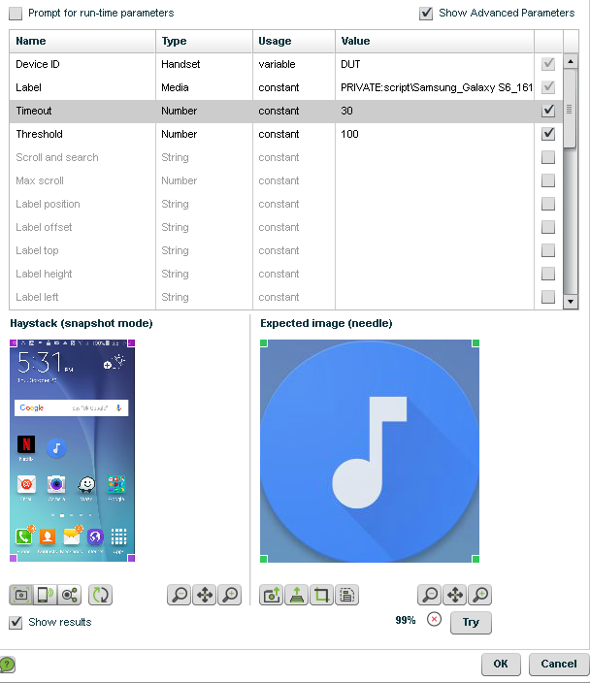
Best Practice
Screenshot - Always take the needle from the highest available resolution to get the sharpest image possible
Crop - Always crop the needle down to the specific object you are searching in order to eliminate any additional noise when matching.
Threshold is also available for Image and should also be set to the highest value possible. Always try to achieve 80% or greater.
Remember to use Match Mode - Bounded Size and Image Bound parameters when moving from the source device of the screenshot to another.
Bad Crop
Good Crop
Notes:
Screen shots can come from the business or development groups for use and in that case bounded size is an absolute necessity however it is best to generate the screen shot from the analysis window.
They need to ensure the screen shot they take is coming from a high resolution device to ensure it is as clear as possible.
They should also crop the screen shot to target EXACTLY what they are searching for so they don’t end up with false positives or false negatives.
Lastly bounded size is always suggested when working with a pool of different devices models to ensure the same image can work across many devices without issue.

Slide 16
Generic Parameters
Timeouts (Best Practice)
Every command you use should have a value set for the Timeout parameter unless you are using Scroll and Search.
This will ensure your command doesn’t fail in the event the object hasn’t fully loaded yet.
If the command succeeds before the timeout it will return and your execution will resume at that point. If the command isn’t successful the execution will halt until the timeout expires and then an exception will be thrown.
Index
When multiple elements are found you can target individual objects by defining the numeric index.
Haystack – top/height/left/width
Set the haystack values (in pixels or percent values) to isolate analysis to that portion of the screen. If you use the Haystack windows drag icons on the corners, these parameters will be set for you automatically.
Notes:
Demonstrate the commands in the analysis window and then record in code and refactor into reusable methods.
EVERY COMMAND needs a timeout value set. If the timeout isn’t needed because the object is already on the screen then the command will ignore it but in the case where it is needed it can be utilized.
There may be small corner cases where a timeout wouldn’t be desired like if you are checking for the existence of many objects to control conditions and you are sure the page has finished loading then adding a timeout could slow down your script.
In 99% of all cases though it should absolutely be used.
Index allows you to target individual objects which have been found based on the needle
Haystack – ideally this should be set by dragging in the analysis window however the users could opt to pass values to their methods created in code to dynamically set these values.

Slide 17
Command Specific Parameters
Checkpoints
Expected result
Set to Pass or Fail based on if your checkpoint is a negative or positive checkpoint.
Button and Select
Operation
You can set to single tap, double tap, or long tap.
Repeat
You can indicate how many times to perform the Operation
When you need to click an element surrounding your needle you can use the below parameters
Button
Label Position
The direction of where the needle is in relation to where you want to click
Label Offset (pixel or percent)
The offset of the click in relation to where the needle is located
Select
Touch position direction
The direction of where the needle is in relation to where you want to click
Touch position value (pixel or percent)
The offset of the click in relation to where the needle is located
Notes:
Demonstrate the commands in the analysis window and then record in code and refactor into reusable methods.
Checkpoints
Expected Results – you can set the pass/fail to be based on negative or positive results. If you DO NOT want to find an object and your find fails to find it you can have it report success instead of failure for instance.
Button and Select
Operation and Repeat are to be used in conjunction with one another. Operation allows you to define exactly what you want the Button or Select command to perform, repeat defines how many times to perform the function.
Button and Select – Offset Click
Button – Label Position and Offset
Select- Touch Position direction and value
All of the parameters work the same just named differently, they allow you to set the click relative to the needle being found. For instance you find a needle called “Click Here” and you want to click the + sign next to it you could indicate a position of right and an offset of 50 and click the + sign instead.

Slide 18
Knowledge Check!
If you want to check that an object IS NOT on the screen what command would you use and would you need to set any special parameters?
What are some of the best practices to use for Image Analysis?
Notes:
Check (checkpoint) - Expected Results should be set to Fail
Bounded Size – Image Bound Tablets 70 and Phone 30
Make sure to always crop the image down to get rid of background noise
Take image from highest resolution possible
80%> on threshold

Slide 19
Scroll and Search
Advanced Visual Functions

Slide 20
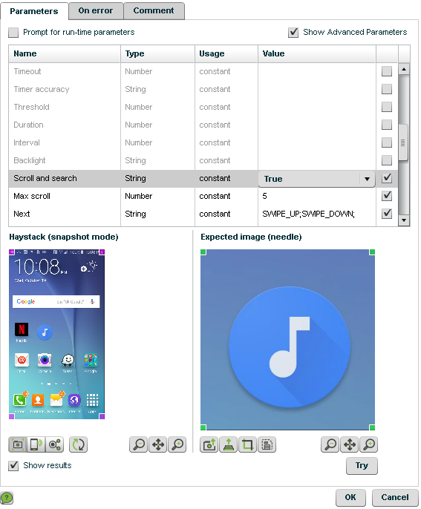
Scroll and Search
Both OCR and Image offer the ability to Scroll and Search for the text or image specified in the needle. There are a few parameters to help with the process.
Timeout
Disable this to use scroll and search
Scroll and Search
Set to True to enable
Next
You can select a single value from the drop down or you can string multiple commands together using a semicolon as shown here.
Max Scroll
How many times to perform the Next commands in between analysis before it stops trying.
Notes:
When searching for a needle it may not always be present on the screen without first scrolling (up/down or left/right depending on the application).
Scroll and Search allows you to define parameters which will essentially go on a hunt for the needle based on the parameters you set

Slide 21
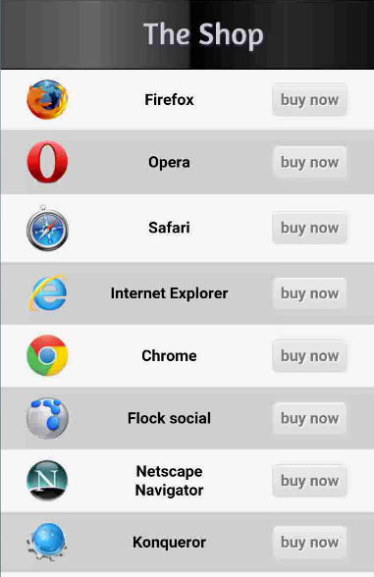
Visual Relations - What’s the Problem
The Need
In the website we see a list of applications for purchase (http://nxc.co.il/demoaut/shop.html)
We would like to click the “buy now” button to the right of the “Application”
The Problem
The “buy now” button is not unique on the page (see lines above and below have the same values).
The Solution
Use Visual Relations!
Notes:
Demonstrate this example to the class by recording the commands from the plugin into code and playing back to show that Chrome’s “buy now” button is being selected. The rest of the slides in this section will help you with this process.

Slide 22
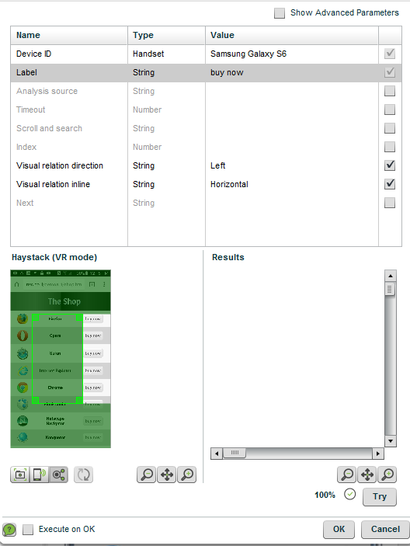
How to Use Visual Relations
Using the example on the previous page
Use the Find command to target a specific Application
The Find command searches for an image or text and stores it in memory for the second command we will use. In our example, use the Find function to search the screen for the Chrome element. The system stores the area coordinates of the first object.
Use a Button or Select command and set the Visual Relation Parameters
Set the Visual Relation Direction parameters to Left and Visual Relation Inline parameter to Horizontal.
Click the Visual Relation button in the Haystack window and drag the layout to simulate the relationship between the Find command and the Button command (this must be simulated, since the real object will be found during the live run). Once set click on Try to test your search.

Slide 23
Visual Relation Parameters
Visual Relation Inline
Indicates the type of alignment between the first needle (the Application label in the example) and the new needle (buy now).
Values: horizontal or vertical.
Visual relation direction
Indicates the direction relative to the first needle to look for the second needle.
Values: right or left, above or below.
You must ensure you use the parameters together in a combination which makes sense or an error will be thrown. For instance you can’t indicate horizontal (left and right) and set a direction of above or below.

Slide 24
Visual Relations - Code
The below represents what Visual Relations would look when used properly in code
driver.get("http://nxc.co.il/demoaut/shop.html");
Map<String, Object> params1 = new HashMap<>();
params1.put("content", "Chrome");
params1.put("timeout", "30");
params1.put("threshold", "100");
Object result1 = driver.executeScript("mobile:text:find", params1);
Map<String, Object> params2 = new HashMap<>();
params2.put("label", "buy now");
params2.put("relation.direction", "left");
params2.put("relation.inline", "horizontal");
params2.put("timeout", "30");
params2.put("threshold", "100");
Object result2 = driver.executeScript("mobile:button-text:click", params2);

Slide 25
Summary
In this module we:
Reviewed the available commands and parameters available through Visual Analysis
Learned when and how to take advantage of these commands and the best practices when using them.
Saw how to record and refactor the code for these commands in our framework to make them into reusable methods.
You should now know how to effectively use Visual Analysis to complement your object based testing.

Slide 26
Resources
​Visual Analysis - https://developers.perfectomobile.com/display/PD/Basic+Visual+Analysis
Commands - https://developers.perfectomobile.com/display/PD/Visual+Analysis+Functions
Parameters - https://developers.perfectomobile.com/display/PD/General+Visual+Analysis+Parameters
Visual Relations - https://developers.perfectomobile.com/display/PD/Visual+Relations

Slide 27
Thank You

